Slide 1
UNIT- 5
HUMAN COMPUTER INTERACTION
Deepa R
Assistant Professor

Slide 2
AFFECTIVE ASPECTS
“Affective “ refers to the generation of an emotional response.
Affective behavior can also trigger an emotional response in others.

Slide 3
Emotional Interaction
Design of Interactive products may cause certain kinds of emotional responses in people.
Emotional Interaction is concerned with how we feel when first finding out about a new product to getting rid of it.

Slide 4
Emotional Interaction
Emotional interaction is about considering what makes us happy, sad ,annoyed, anxious, frustrated, motivated and so on.
It is also about translating this knowledge into different aspects of the user experience.
It is about understanding the relationships between facial expressions , body language , gestures and tone of voice

Slide 5
Expressive interfaces
Expressive forms like emoticons, sounds, icons and virtual agents have been used at the interface
(i) convey emotional states
(ii)elicit certain kinds of emotions in users such as feeling at ease, comfort and happiness.
A well-known approach to designing affective interfaces is to use expressive icons
Other ways of conveying the status of a system are through
Dynamic icons-recycle bin expanding
Animations-bee flying across the screen indicating that the computer is doing something such as checking files.
Spoken messages.
Various sounds indicating actions and events

Slide 6
A universal method is the use of emoticons, originally keyboard symbols that were combined in various ways to convey feelings and emotions by simulating facial expressions
Happy - :)
Sad - :(
Mad >:
Very angry >:-(
Sick :x

Slide 7
Frustrating Interfaces
In many situations , computer interfaces may inadvertently elicit negative emotional responses such as anger and disgust.
When an application doesn’t work properly or crashes.
When a system doesn’t do what the user wants to do.
When the user expectations are not met.
When error messages pops up that are vague or obtuse.
When the appearance is too noisy , garish, Gimmicky.

Slide 8
User frustration
When an application doesn’t work properly or crashes
System doesn’t do what the user wants it to do
When a users expectations are not met
When a system does not provide sufficient information to let the user know what to do
Error messages pop up that are vague
When the appearance of an interface is too noise, gimmicky,..

Slide 9
Gimmicks
Cause: when users expectations are not met and they are instead presented with a gimmicky display
Eg. You click on a website and discover it is still under construction. The website owners may think that it is amusing, it merely increases the user frustration.

Slide 10
Error messages
Ideal error messages should be treated as “how-to-fix-it” messages.
Eg. They should state the cause of the problem, and what the user needs to do to fix it.
Avoid terms like FATAL , INVALID, BAD , ILLEGAL
Use friendly language such that would help users to understand the cause of the problem and how to fix it.
Eg. Syntax error.
Invalid filename
Invalid data

Slide 11
Overburdening the user
Cause: upgrading software so that users are required to carry out excessive house keeping tasks
Frustration: medium to high
Eg. Frustration in trying to run many websites require installing additional plugins.

Slide 12
Appearance
Cause: when the appearance of an interface is unpleasant
Frustration: Medium
Eg. Flashing animations ,especially banner ads which are very distracting
eg: Childish agents that keep popping up on the screen , such as kinds of helper agents

Slide 13
Anthropomorphism in ID
Anthropomorphism is the “propensity people have to attribute human qualities to objects”
Zoomorphism is the shaping of the object or design in animal form.
Eg. People treat mobiles as their pets and give cute names for them.
Advertisers are well aware of this phenomenon and often create humanlike characters out of inanimate objects to promote their products.
Eg. Children are susceptible to this kind of “ magic” as witnessed in their love of cartoons

Slide 14
Virtual characters: Agents
They are agents to help us search the web, as e-commerce assistants that give us information about products, as characters in video games, as learning companions or instructors in education programs and many more
Eg. Artificial anthropomorphized characters like Pokémon creatures

Slide 15
Kinds of agents
Synthetic-used in 3D characters in video games
Animated agents : They appear as tutors, wizards and helpers on screen
Emotional agents - allows users to change the mood of the agent
Embodied conversational interface agents-
  Recognizing & responding to verbal and non-verbal input
  Generating verbal and non-verbal output
  Coping with breakdowns, turn taking and other conversational mechanisms
  Giving signals that indicate the state of conversation as well as contributing new suggestions

Slide 16
General design concerns
Believability of virtual characters
Appearance
Behavior
Mode of interaction

Slide 17
Process of interaction design

Slide 18
Interaction design
Design is a plan or scheme conceived in the mind and intended for subsequent execution
It involves developing a plan which is informed by the products intended use, target domain and relevant practical considerations
Alternative designs need to be generated, captured, and evaluated by users

Slide 19
The importance of involving users
Involve real users throughout the development
Expectation management – ensure users views and expectations for the new product is met.
Adequate and timely training is another technique for managing expectations

Slide 20
User centered approach
Early focus on users and tasks
Empirical measurement
Iterative design

Slide 21
4 Basic activities
Identifying needs and establishing requirements
Developing alternative designs
  Conceptual
  Physical
Building interactive versions of the design
Evaluating designs

Slide 22
3 characteristics of interaction design
Focus on users
Specific usability and user experience goals
Iteration

Slide 23
Practical Issues
Who are the users
  Primary
  Secondary
  Tertiary
What do we mean by needs
How do you generate alternate designs
How do you choose among alternatives

Slide 24
Life cycle models
Waterfall
Spiral
Rapid Applications Development

Slide 25
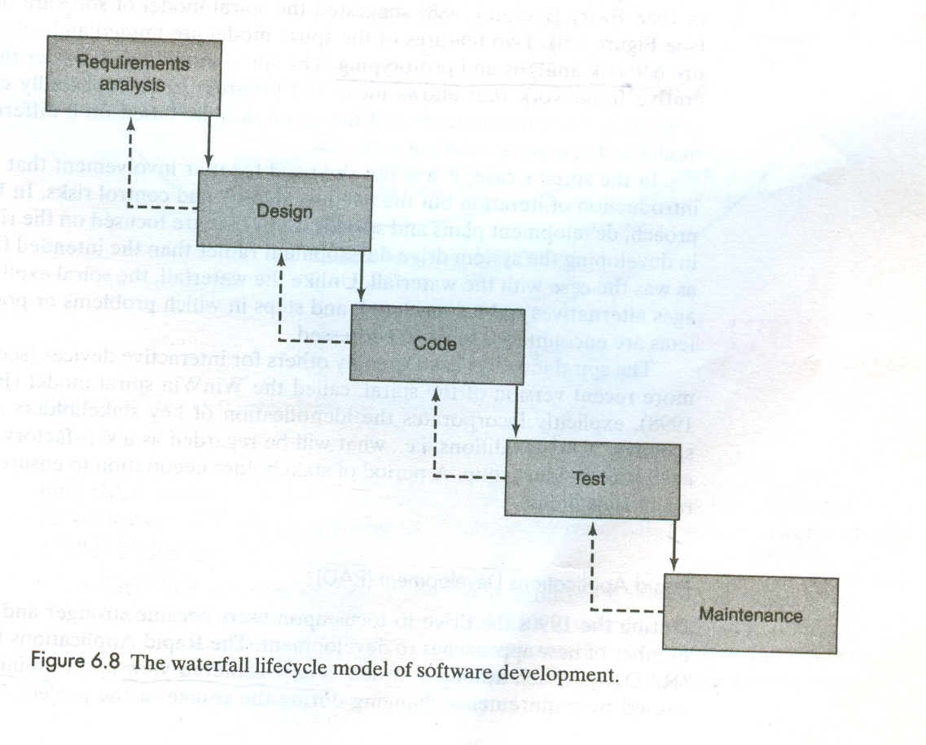

Slide 26
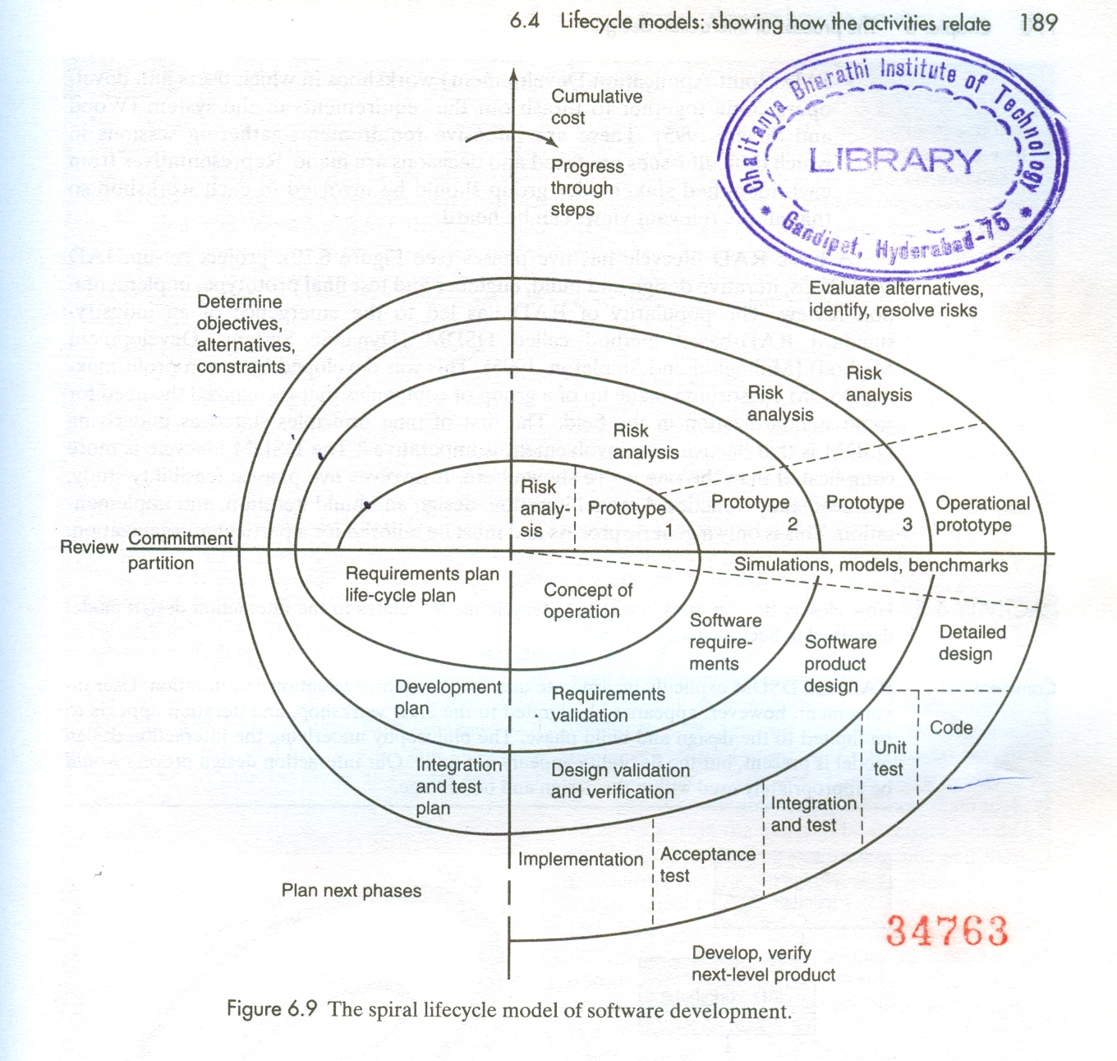

Slide 27
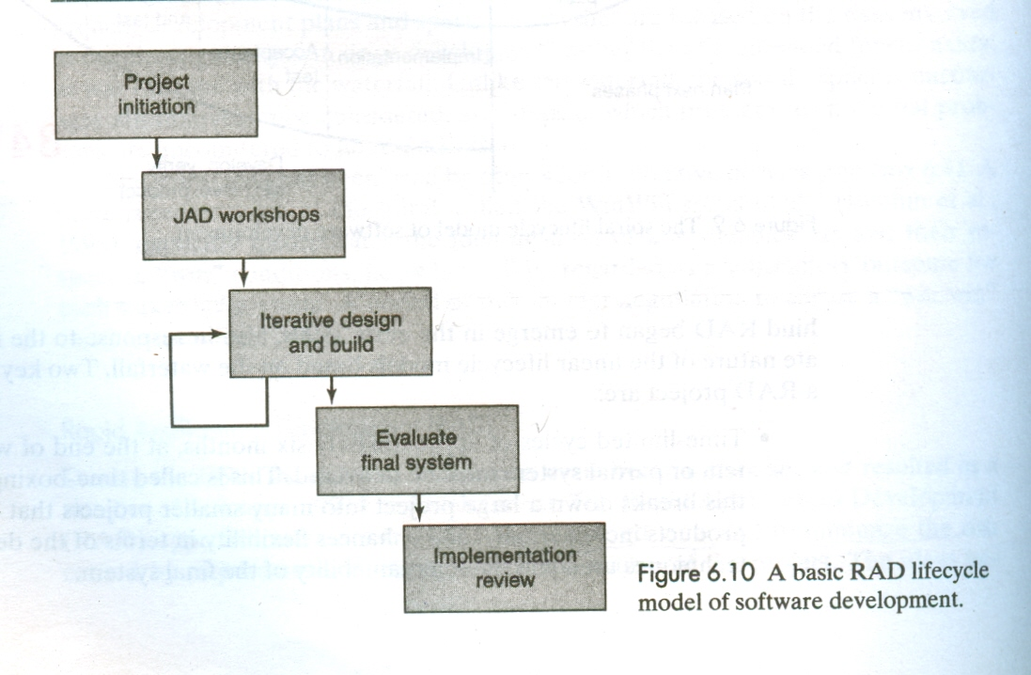

Slide 28
Life cycle models in HCI
Star Lifecycle model
The usability engineering lifecycle=

Slide 29
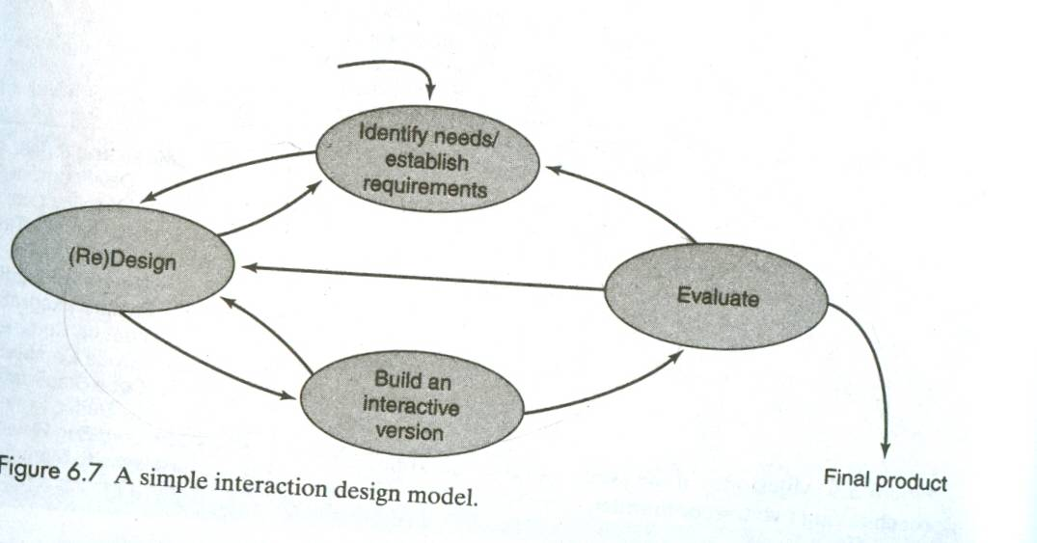
Design, prototyping and construction

Slide 30
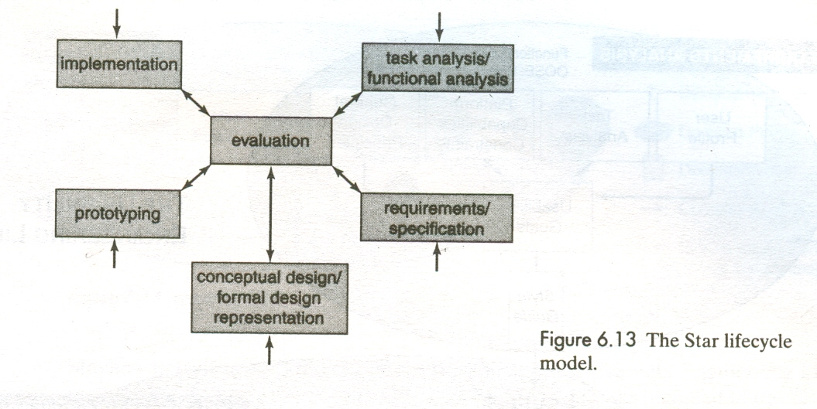

Slide 31
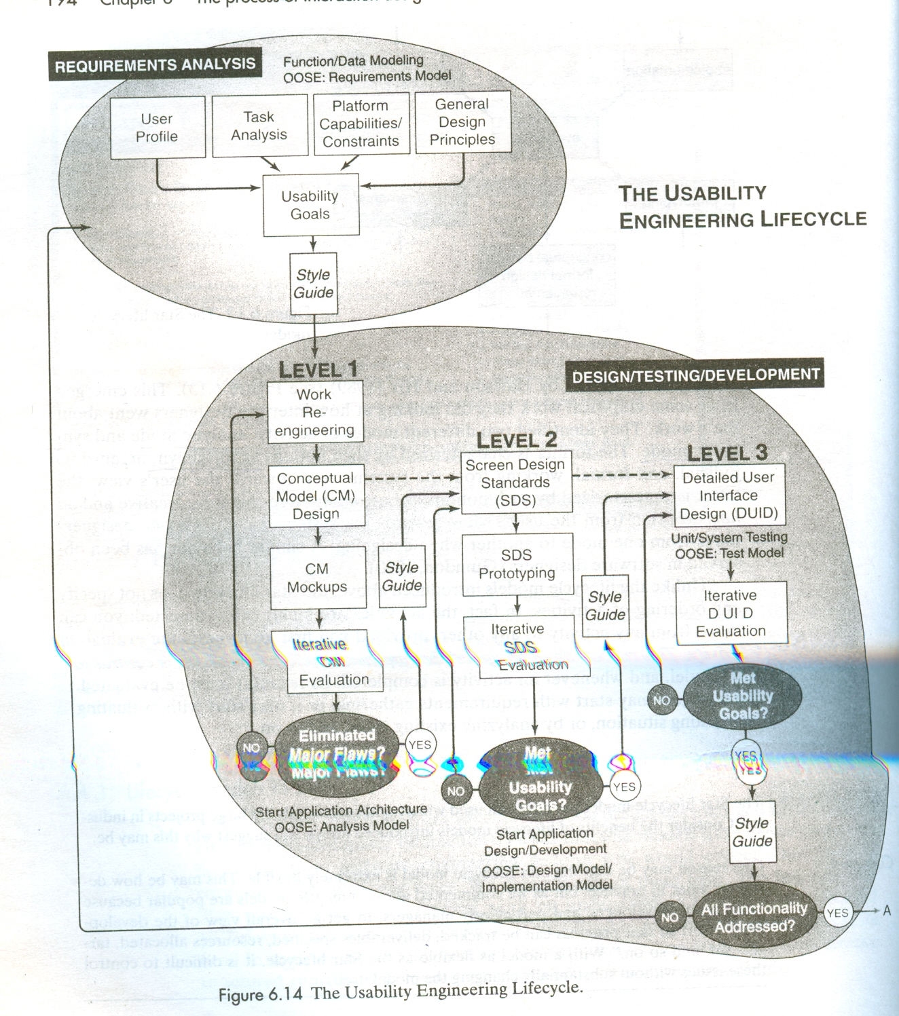

Slide 32
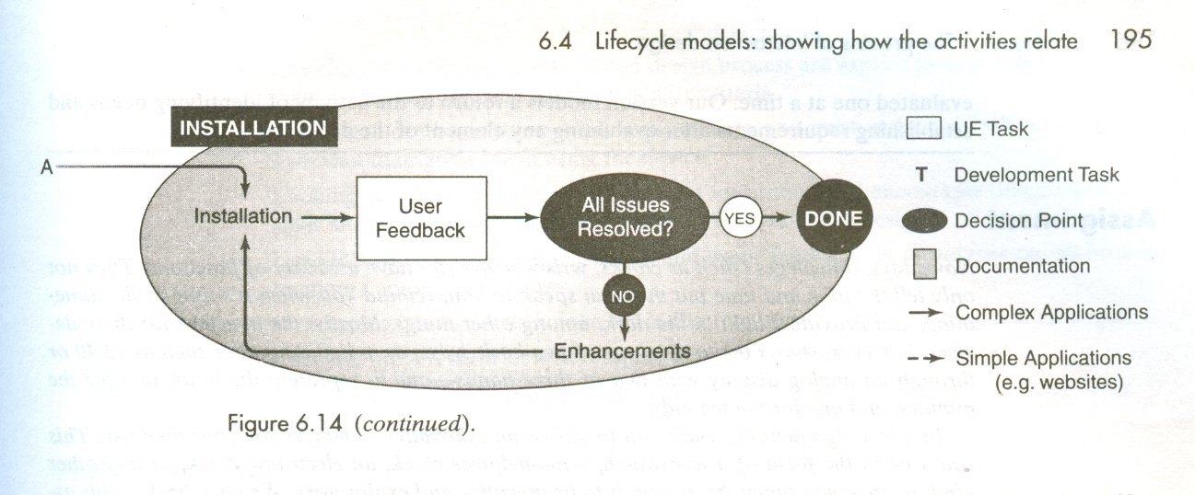

Slide 33
Prototyping and Construction
Prototype is a limited representation of a design that allows users to interact with it and to explore its suitability
Prototypes are a communication device among team members, and are an effective way to test out ideas for yourself
Prototypes answer questions and support designers in choosing between alternatives

Slide 34
Low-fidelity prototyping
A low –fidelity prototype is one that does not look very much like the final product they are useful prototypes as they tend to be simple , cheap and quick to produce.
Story boarding
Sketching
Wizard of Oz

Slide 35
High-fidelity prototyping
Uses materials that you would expect to be in the final product and produces a prototype that looks much more like the final thing

Slide 36
Compromises in prototyping
Horizontal prototyping
  Wide range of functions but with little detail
Vertical prototyping
  Lot of detail for only a few functions

Slide 37
Construction
Evolutionary prototyping
Throwaway prototyping

Slide 38
Conceptual design- guiding principles
Keep an open mind but never forget the users and their context
Discuss ideas with other stake holders as much as possible
Use low-fidelity prototyping to get rapid feedback
Iterate, Iterate, Iterate, …

Slide 39
3 perspectives for developing a conceptual model
Interface metaphors
Interaction types
Interface types

Slide 40
Expanding the conceptual model
What functions will the product perform
How are the functions related to each other
What information needs to be available

Slide 41
Using scenarios in conceptual design
Four roles for scenarios
  As a basis for the overall design
  For technical implementation
  As a means of cooperation within design teams
  As a means of cooperation across professional boundaries i.e., as a basis of communication in a multidisciplinary team

Slide 42
Physical design: Getting concrete
Strive for consistency
Enable frequent users to use shortcuts
Offer informative feedback
Design dialogs to yield closure
Offer error prevention and simple error handling
Permit easy reversal of actions
Reduce short-term memory load

Slide 43
Evaluation

Slide 44
What, why and when to Evaluate
What to evaluate
Why you need to evaluate
  Problems are fixed before the product is shipped, not after
  The team can concentrate on real problems, not imaginary ones
  Engineers code instead of debating..
When to evaluate
Where to evaluate.

Slide 45
Evaluation Framework
Determine the goals
Explore the questions
Choose the evaluation approach and methods
Identify the practical issues
Decide how to deal with the ethical issues
Evaluate,analyze,intepret,and present the data

Slide 46
Usability Testing
Usability Testing is an approach that emphasizes the property of being usable, i.e. it is the product that is tested rather than the user
The goal is to test whether the product being developed is usable by the intended user population to achieve the tasks for which it was designed

